Slide 1
Fast Food Or Fat Food?
A Search for Significance
By Danford Compton

Slide 2
Exploring the links between fast food and obesity in the United States
A slightly misguided effort.

Slide 3
So why Fast Food Specifically?

Slide 4
Because it’s bad for you!
Fast food has large amounts of
And small amounts of
Sodium
Saturated Fat
Trans Fat
Sugar
Cholesterol
Nutrients
Antioxidants
Fiber

Slide 5
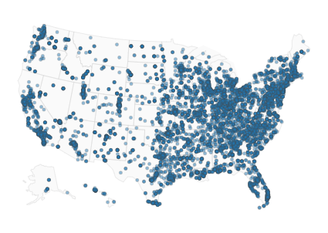
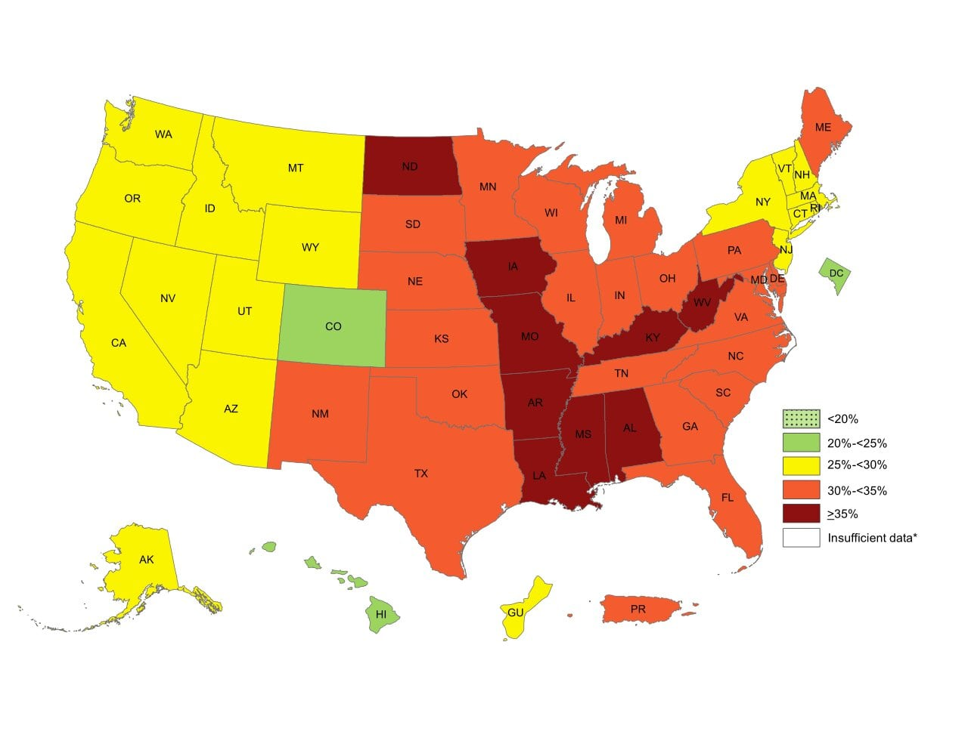
The Images that made me believe...
Fast food restaurants in the United States
Obesity rates in the United States
Easy Peasy Lemon Squeezy, Right?

Slide 6
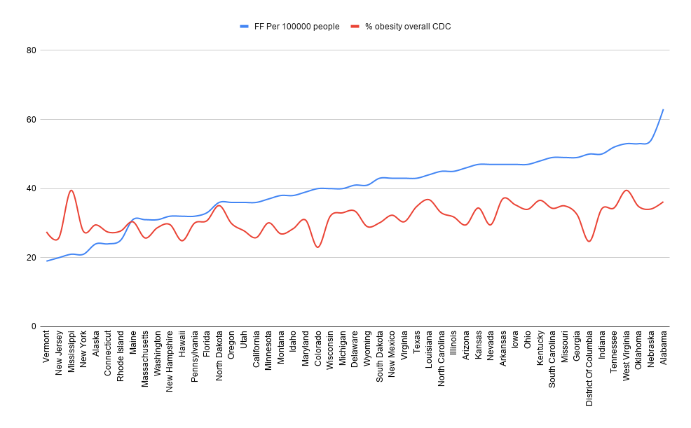
Not so much...
Correlation:
.515
Not Great.
Sources:
CDC for obesity numbers.
Datafiniti for restaurant numbers

Slide 7
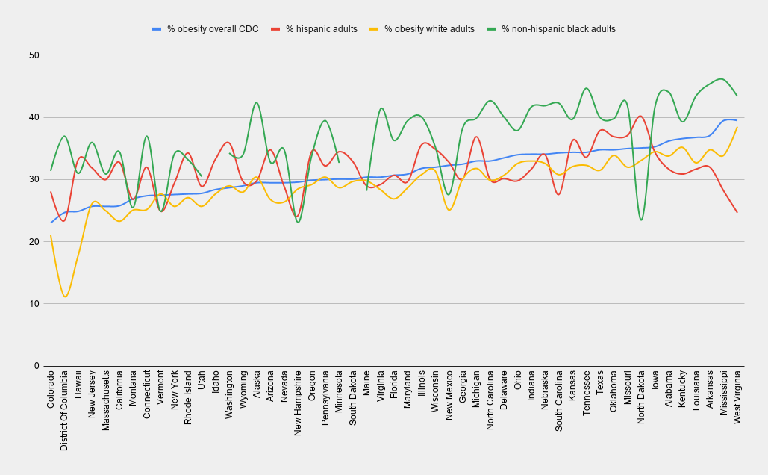
So what does the CDC data say?
It’s actually quite odd!
It’s time for some new data!

Slide 8
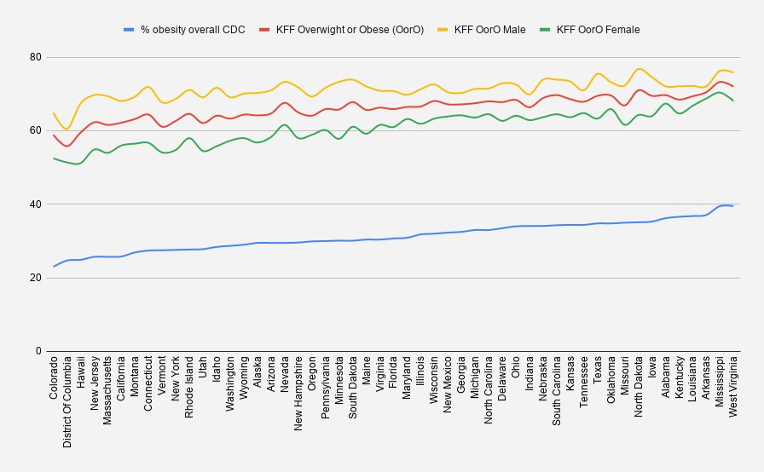
Enter the KFF
The Kaiser Family Foundation
Correlation with CDC data is .929!
This gives us gender data, at the cost of their data lumping overweight and obese together.
But does that help us?

Slide 9
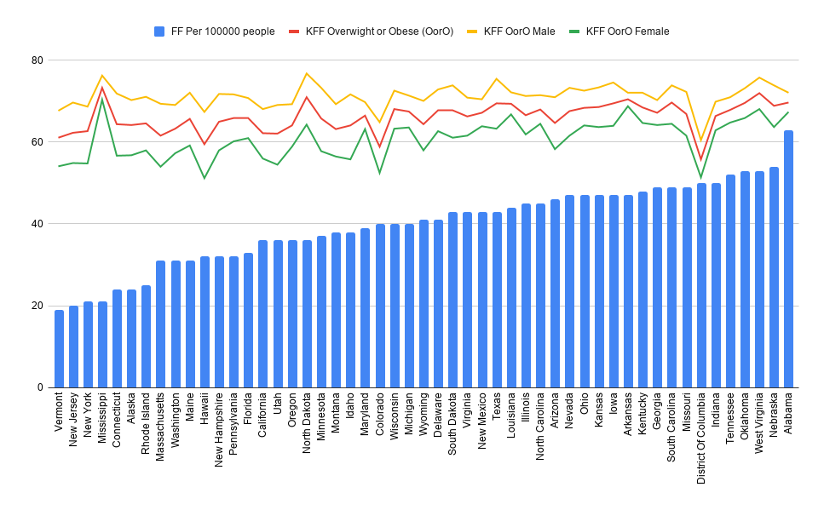
The extra data helps us… slightly
Correlation Between:
Fast Food and Overall:
.42
Fast Food and Males:
.19
Fast Food and Females:
.535

Slide 10
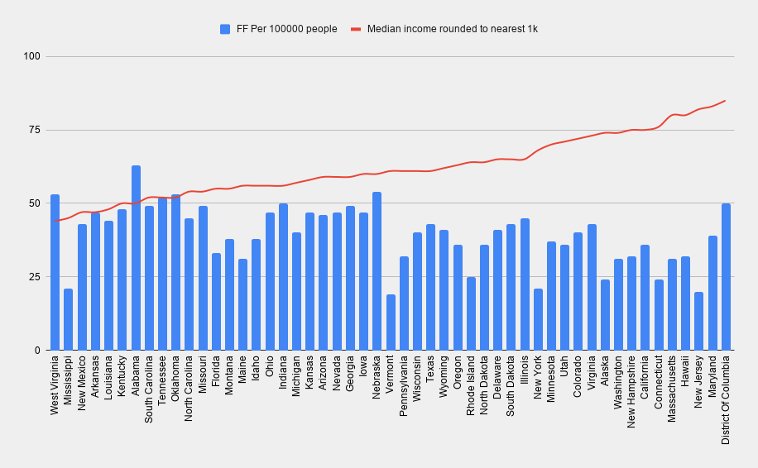
So let’s talk about income
This gives us a negative correlation:
-.448
How does this work with obesity?

Slide 11
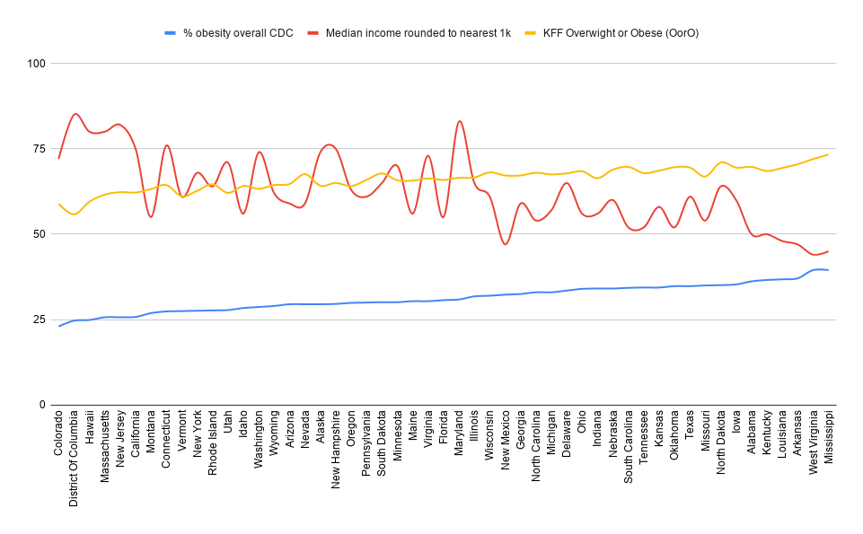
Similarly!
Correlation between income and KFF Overweight or Obese: -.722
Correlation between income and CDC obesity: -.763

Slide 12
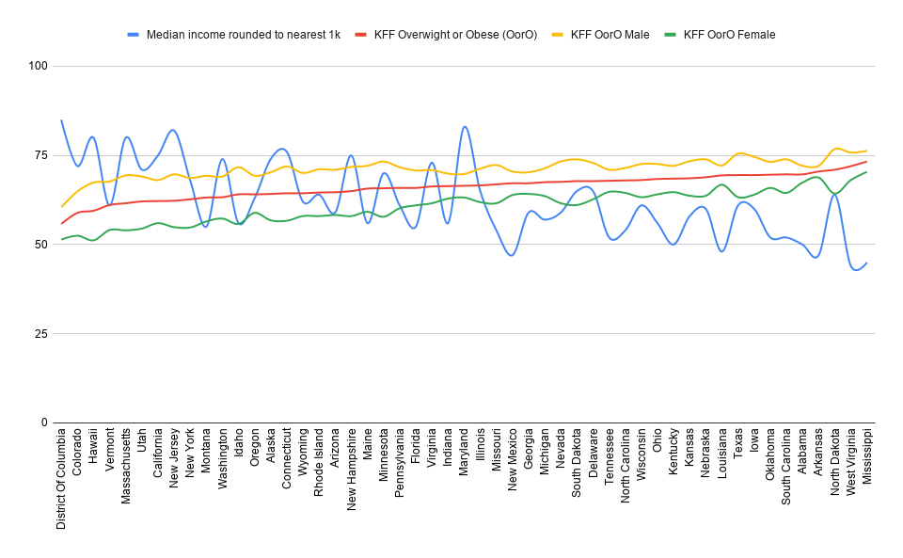
Income and KFF Overweight or Obese Data
Correlation between Income and OorO Males: -.552
Coorleation between Income and OorO Females: -.751

Slide 13
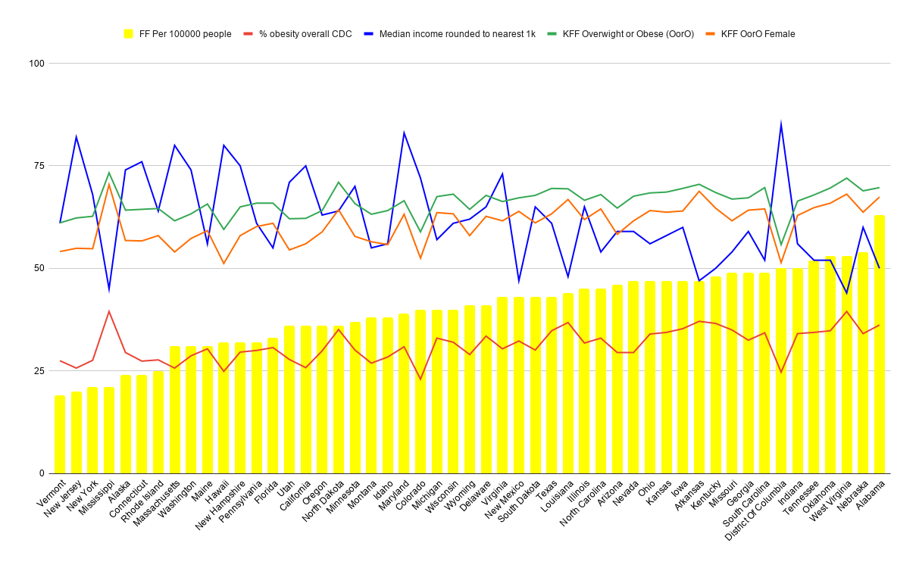
The Big Graph Of Statistical Relevance (BGOSR)
The number of Fast Food Restaurants has some correlation with obesity(.515), but not at much as income and obesity. (-.722)
The correlation is higher for females than males or overall in all cases.

Slide 14
How this meshes with other studies
AKA This isn’t a thing
A similar study by Jay Maddock done in 2004 came up with a correlation between the number of fast food restaurants in a county and the obesity rates at .53, which is higher than the numbers that I have.
Why this matters is way back in 2004 the percentages of obese people were significantly lower, with Colorado at the low end with 16.5% (23% in 2018, still the low end) and the high end being West Virginia at 27.6% (39.5% in 2018, still the high end)
So obesity is still increasing but the overall correlation to fast food is falling.

Slide 15
Some Data Issues
The CDC data is self-reported.
Both the CDC data and the KFF data define overweight and obese by BMI, which is generally ok, but imprecise.
The Fast Food restaurant data does not include other services that fill a similar niche. Ex: coffee shops.

Slide 16
Eating Is Complicated
It’s always going to have a variety of costs; time, money, effort, etc.
It’s heavily influenced by personal desires that cannot be quantified on a large scale.
Despite what this project is trying to show, not eating fast food =/= eating healthier food. Ex: frozen TV dinners.

Slide 17
Thank You!
Please make healthy eating choices!

